Slide 1

SURAKSHA
AN INTELLIGENT VULNERABILITY SCANNER
Name : K PRANAV ESWAR
Reg No. : LMC25MCA-2034
Dept : S3 MCA
GUIDE : Ms BISMI K CHARLEYS

Slide 2

INTRODUCTION
A WEB-BASED CYBERSECURITY VULNERABILITY ASSESSMENT PLATFORM.
It combines different security checks in a single system:
  Web Vulnerability Scanning
  Network Reconnaissance
  SSL/TLS Security Analysis
  Protocol Analysis
  CVE Mapping
  ML-Based Risk Prediction
TRUST
Flow in simple words:
Detect → Analyse → Assess → Report
01

Slide 3
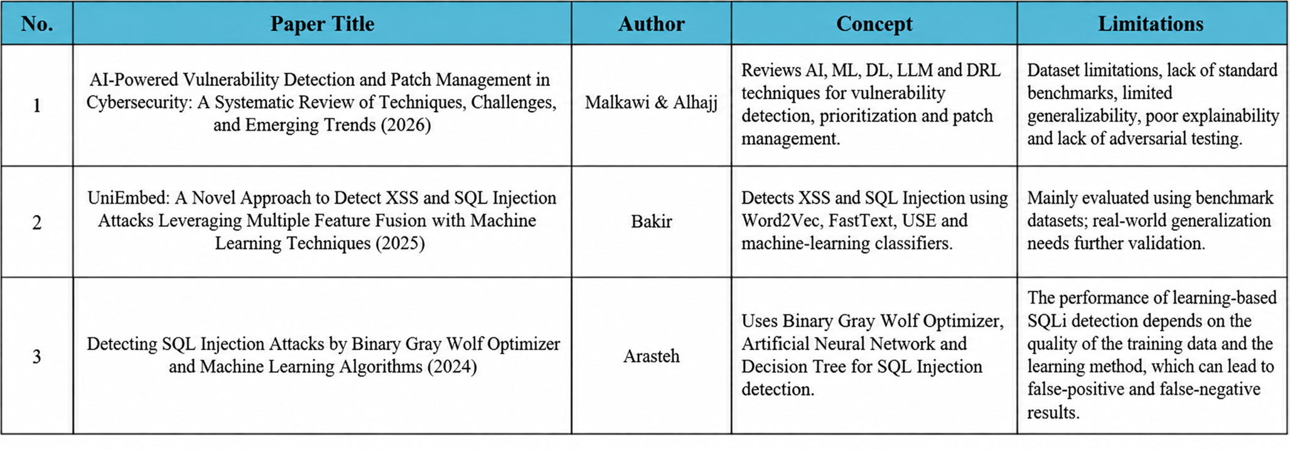
LITERATURE SURVEY
02

Slide 4
EXISTING SYSTEM
Separate tools for different security assessments.
Web and network vulnerabilities analyzed independently.
Mostly rule-based detection.
Limited automated risk prioritization.
Manual analysis of security reports is often required.
Problem statement
  Requires multiple specialized tools for cybersecurity assessment.
  Raw technical outputs - difficult for non-experts to understand.
  Vulnerability detection - not indicate risk or priority.
  Security findings - fragmented across different assessment areas.
03

Slide 5
RESEARCH GAP/STUDY
  Existing research - focuses on individual security assessment techniques - often developed independently.
  An integrated platform combining multiple security analyses with ML-based risk prediction - is needed.
OBJECTIVES
  Develop the integrated cybersecurity platform SURAKSHA.
  Perform web vulnerability scanning and network reconnaissance.
  Analyze SSL/TLS security and network protocols.
  Map vulnerabilities to relevant CVE records.
  Predict security risk levels using machine learning.
  Provide centralized, risk-based security findings.
04

Slide 6
PROPOSED SYSTEM
SURAKSHA is an integrated cybersecurity assessment platform that combines multiple security analysis techniques with Ml-based risk prediction.
System includes :
  Performs web vulnerability scanning for SQL Injection, XSS, security headers and sensitive paths.
  Performs network reconnaissance using Nmap for ports, services and versions.
  Checks SSL/TLS configuration and certificate details.
  Performs protocol and service analysis.
  Maps detected services and vulnerabilities to CVE information.
  Uses Machine Learning to support risk prediction.
  Stores scan results and vulnerabilities in a centralized SQLite database.
  Generates reports with severity, risk, evidence and recommendations.
05

Slide 7
TECHNOLOGY STACK
Frontend : HTML · CSS · JavaScript · Bootstrap
Backend : Python · Flask
Database : SQLite3
Machine Learning : Scikit-learn · Joblib · Random Forest
Security Tools : Nmap · Python-Nmap · Requests
06

Slide 8
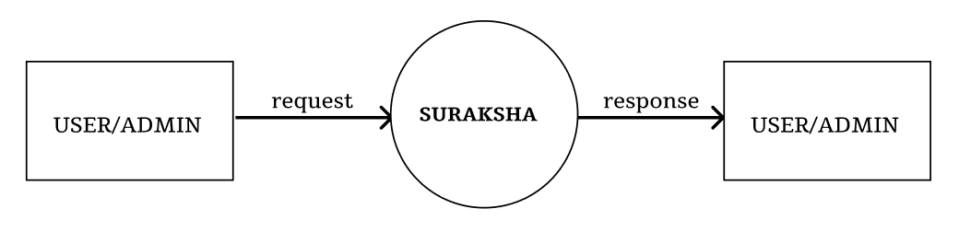
CONTEXT DIAGRAM - LEVEL 0
07

Slide 9
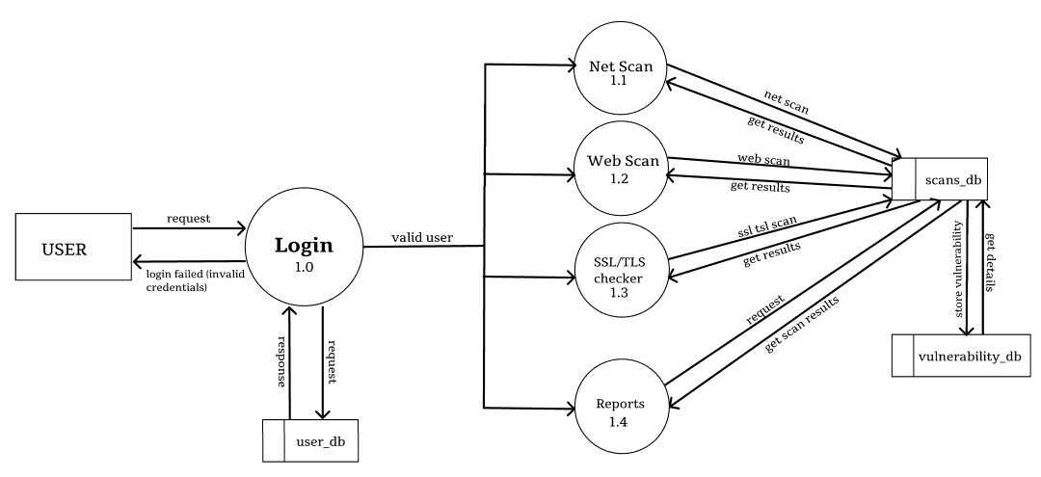
USER - DFD - LEVEl 1
08

Slide 10
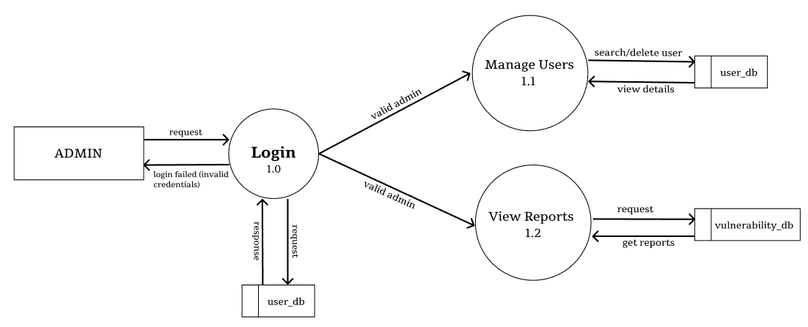
ADMIN - DFD - LEVEL 1
09

Slide 11
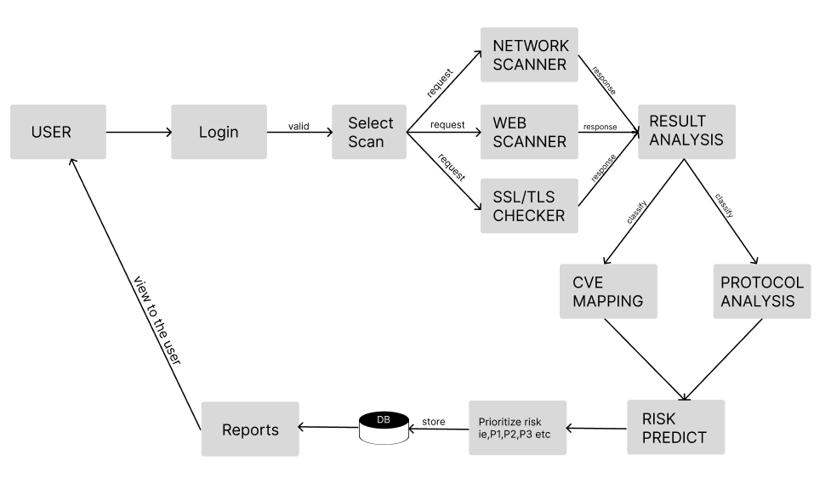
USER - ARCHITECTURAL FLOW
10

Slide 12
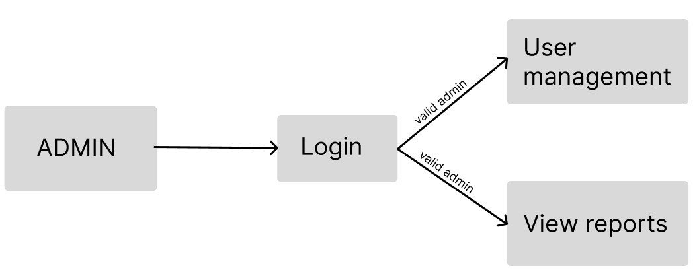
ADMIN - ARCHITECTURAL FLOW
11

Slide 13
DATABASE DESCRIPTION
Schema : scanner.db
Tables : user,scan,vulnerability
User table
Column Name | Data Type | Constraints | Description
id | INTEGER | PRIMARY KEY, NOT NULL | Unique user ID
username | VARCHAR(100) | NOT NULL | User's name
email | VARCHAR(120) | NOT NULL, UNIQUE | User's email address
password | VARCHAR(255) | NOT NULL | User's password or password hash
12

Slide 14
scans table
Column Name | Data Type | Constraints | Description
id | INTEGER | PRIMARY KEY, NOT NULL | Unique scan ID
target | VARCHAR(255) | NOT NULL | Scanned target
scan_type | VARCHAR(100) | NOT NULL | Type of scan
severity | VARCHAR(50) | NOT NULL | Overall scan severity
status | VARCHAR(50) | NULLABLE | Scan status
open_ports | INTEGER | NULLABLE | Number of open ports
details | TEXT | NULLABLE | Scan results and additional information
user_id | INTEGER | NOT NULL, FOREIGN KEY | ID of the user who performed the scan
created_at | DATETIME | NULLABLE | Scan creation date and time
13

Slide 15
vulnerability table
Column Name | Data Type | Constraints | Description
id | INTEGER | PRIMARY KEY, NOT NULL | Unique vulnerability ID
port | INTEGER | NOT NULL | Affected port number
service | VARCHAR(100) | NOT NULL | Network service
protocol | VARCHAR(50) | NULLABLE | Network protocol
vulnerability_name | VARCHAR(255) | NOT NULL | Name of the vulnerability
cve_id | VARCHAR(100) | NULLABLE | CVE identifier
severity | VARCHAR(50) | NOT NULL | Vulnerability severity
attack_type | VARCHAR(255) | NULLABLE | Type of attack
description | TEXT | NULLABLE | Vulnerability description
recommendation | TEXT | NULLABLE | Recommended solution
scan_id | INTEGER | NULLABLE, FOREIGN KEY | Associated scan ID
14

Slide 16

MODULE DESCRIPTION
User Management
Handle reports
Admin
15

Slide 17
Network Reconnaissance
Web Vulnerability Scanning
SSL/TLS Security Analysis
Protocol Analysis
& CVE Mapping
View reports
USER
Access Remediation Recommendations
16

Slide 18
RISK PREDICTION MODULE
ALGORITHM & CONFIGURATION
INPUTS
missing_headers
sensitive_paths
sql_indicators
xss_indicators
https_disabled
server_disclosure
PARAMETER | VALUE
Algorithm | Random Forest
Number of Trees (n_estimators) | 200
Maximum Tree Depth (max_depth) | 10
Random State | 42
Test Size | 20%
Number of Input Features | 6
Output Classes | 4
OUTPUT CLASS
low
medium
high
critical
17

Slide 19
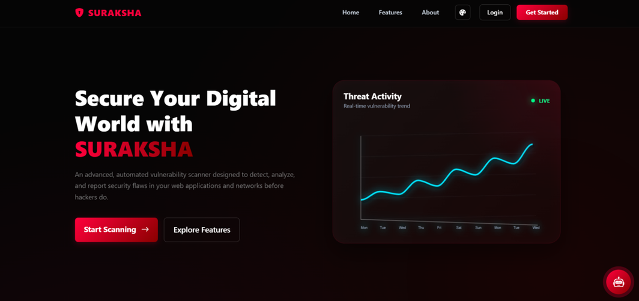
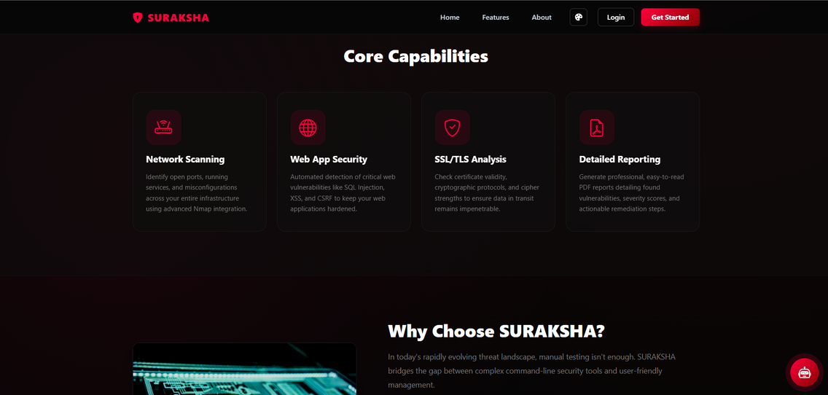
SCREENSHOTS
fig. home page
fig. features page
18

Slide 20
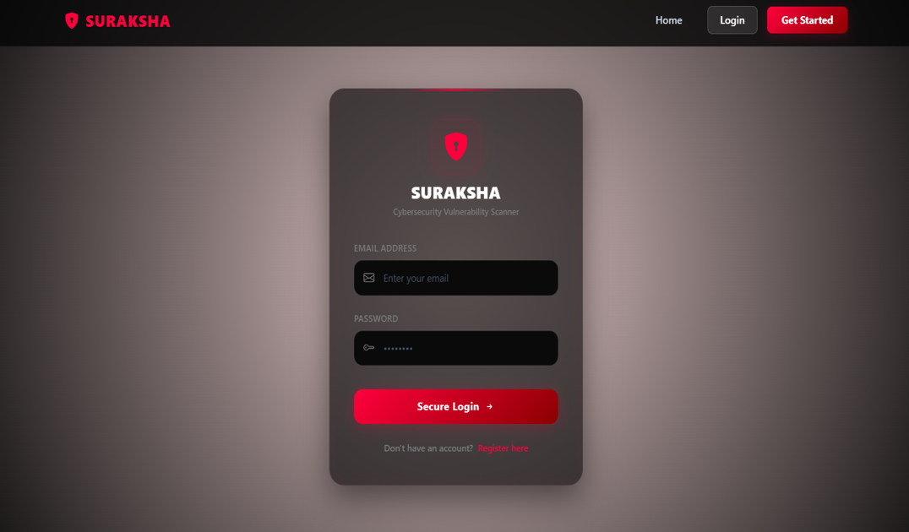
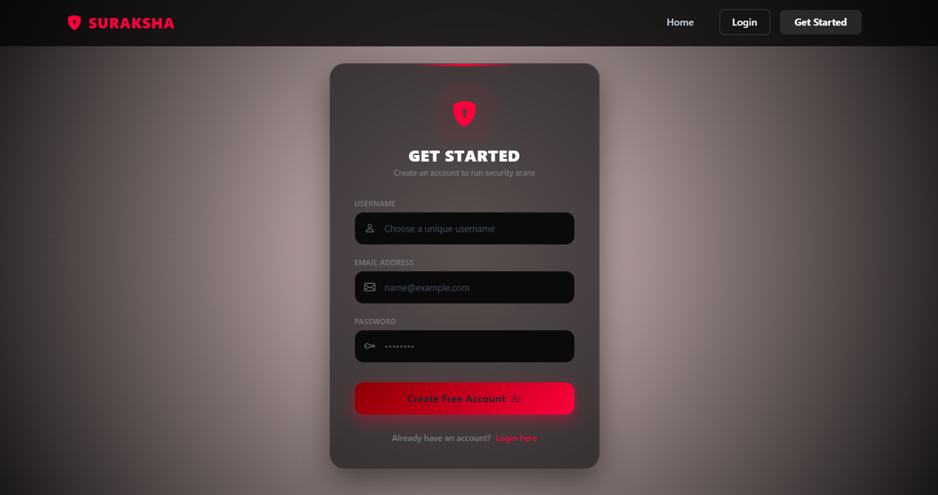
fig. login page
fig. register page
19

Slide 21
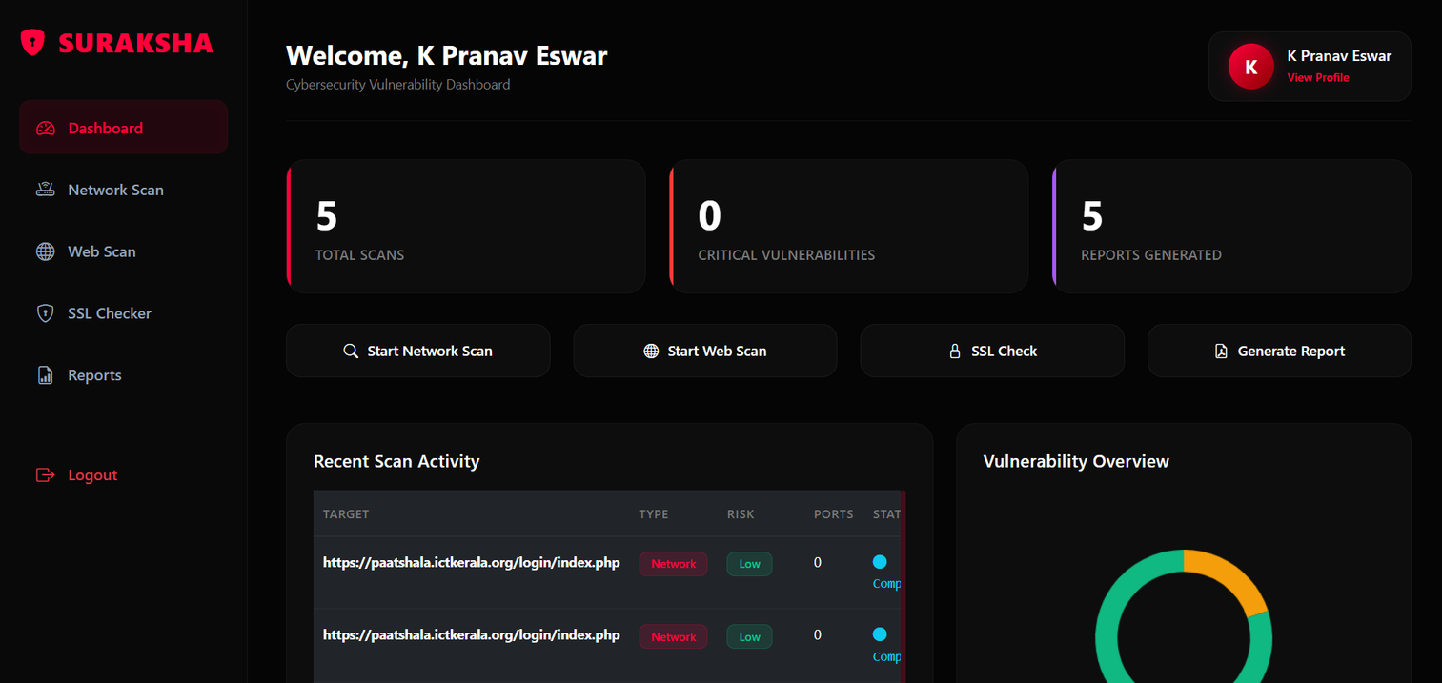
fig. dashboard page
20

Slide 22
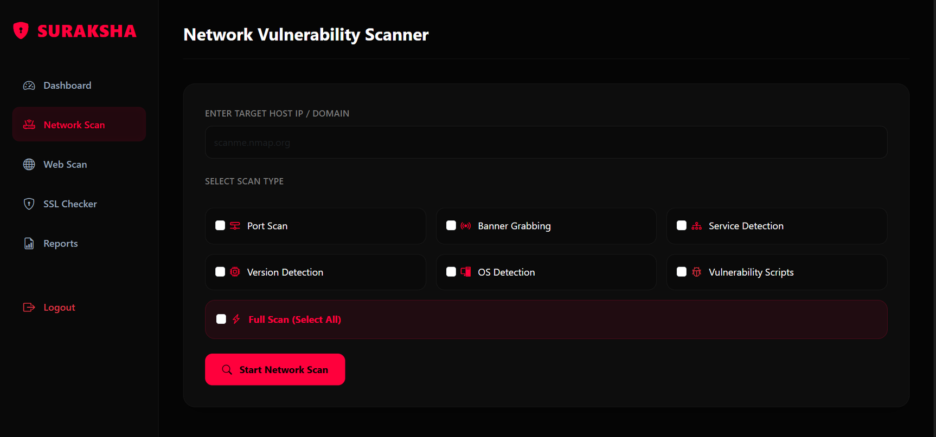
fig. network scanner page
21

Slide 23
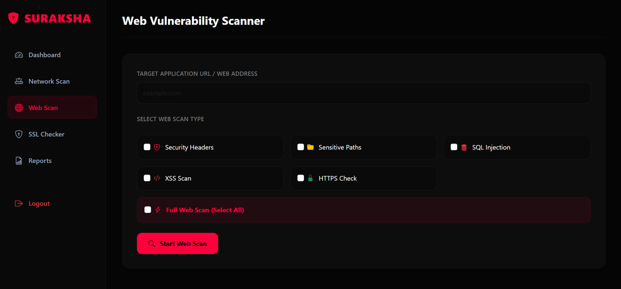
fig. web scanner page
22

Slide 24
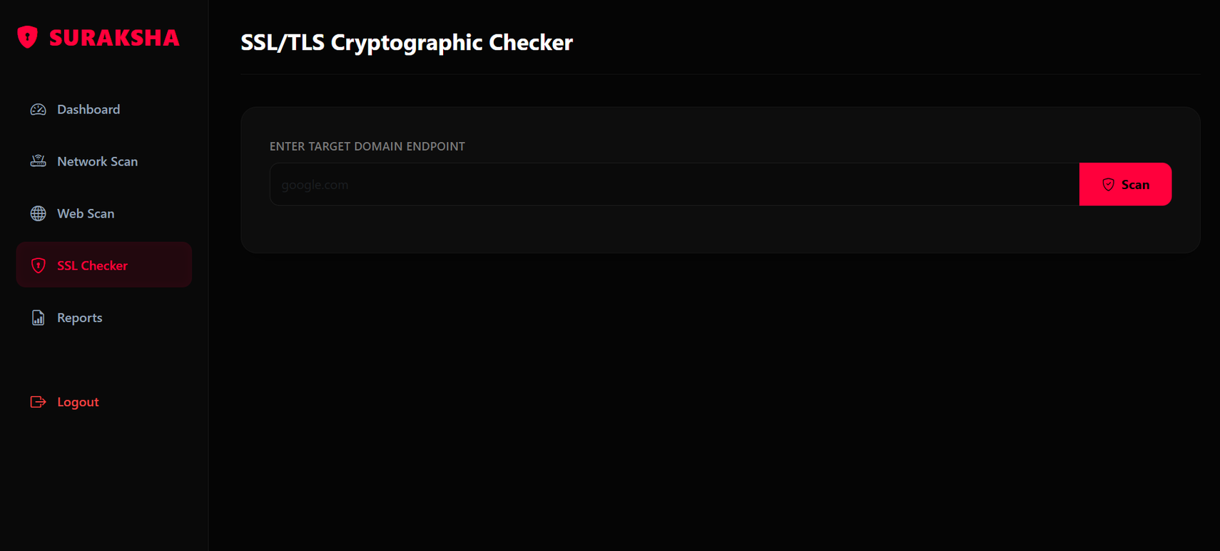
fig. SSL / TLS checker page
23

Slide 25
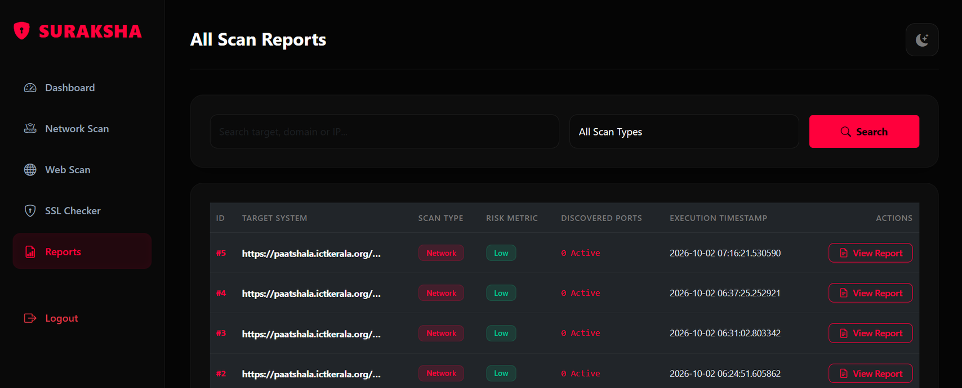
fig. reports page
24

Slide 26
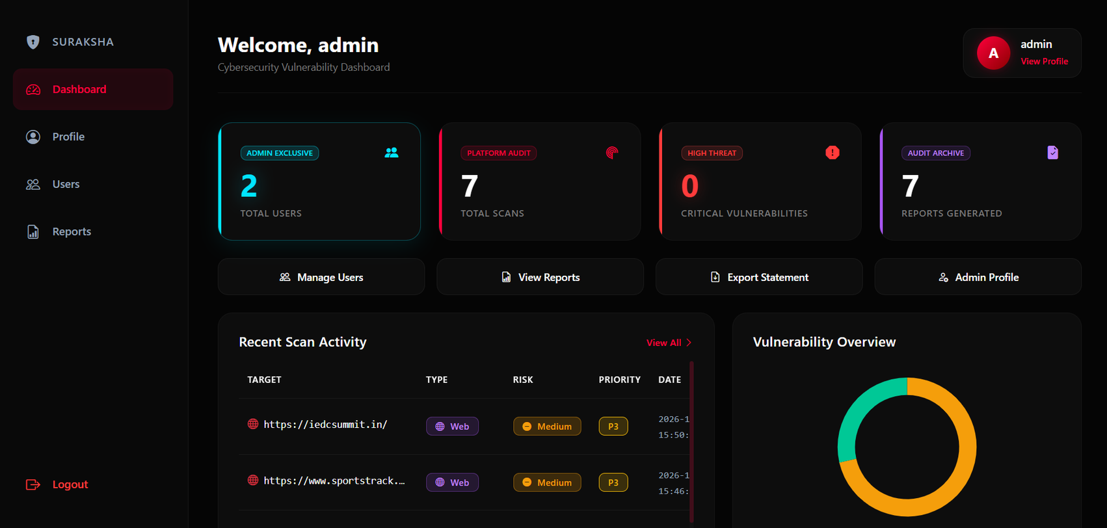
fig. admin dashboard
25

Slide 27
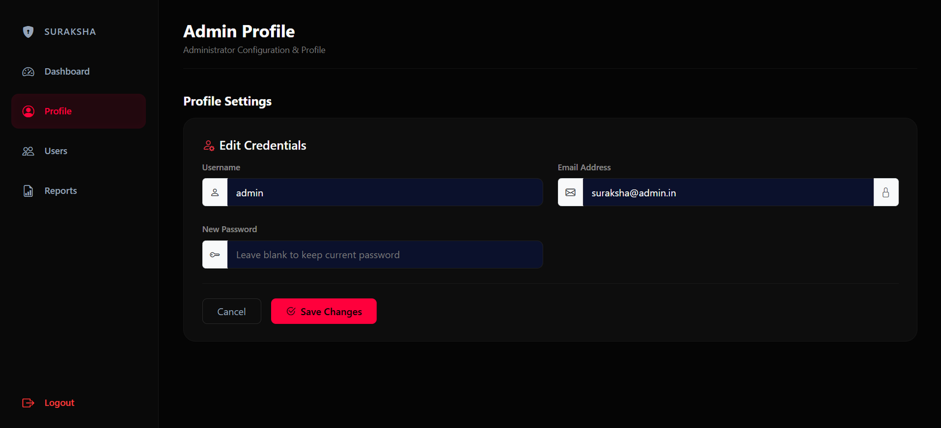
fig. admin profile
26

Slide 28
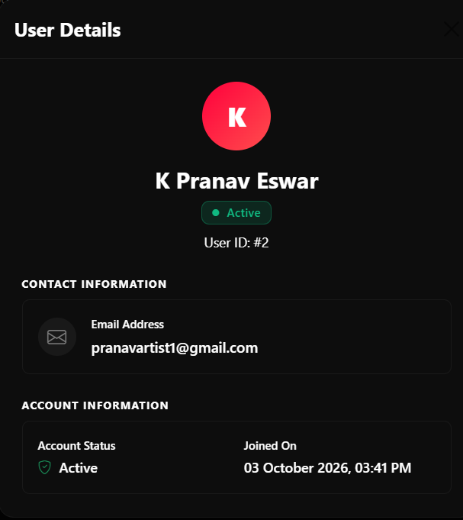
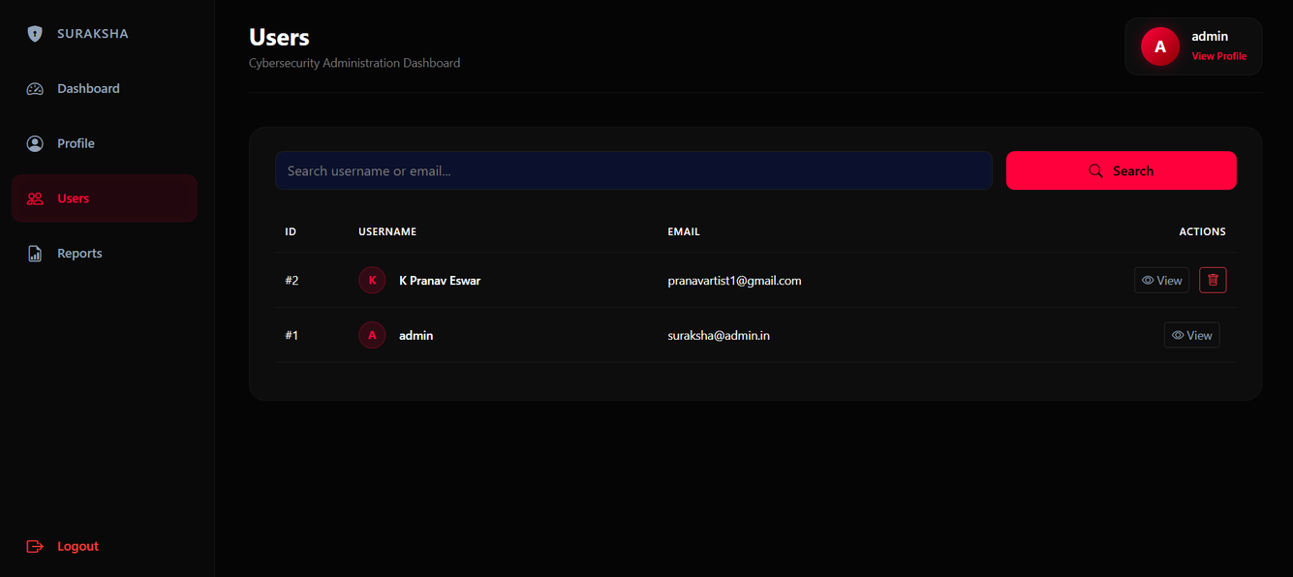
fig. admin / user management
27

Slide 29
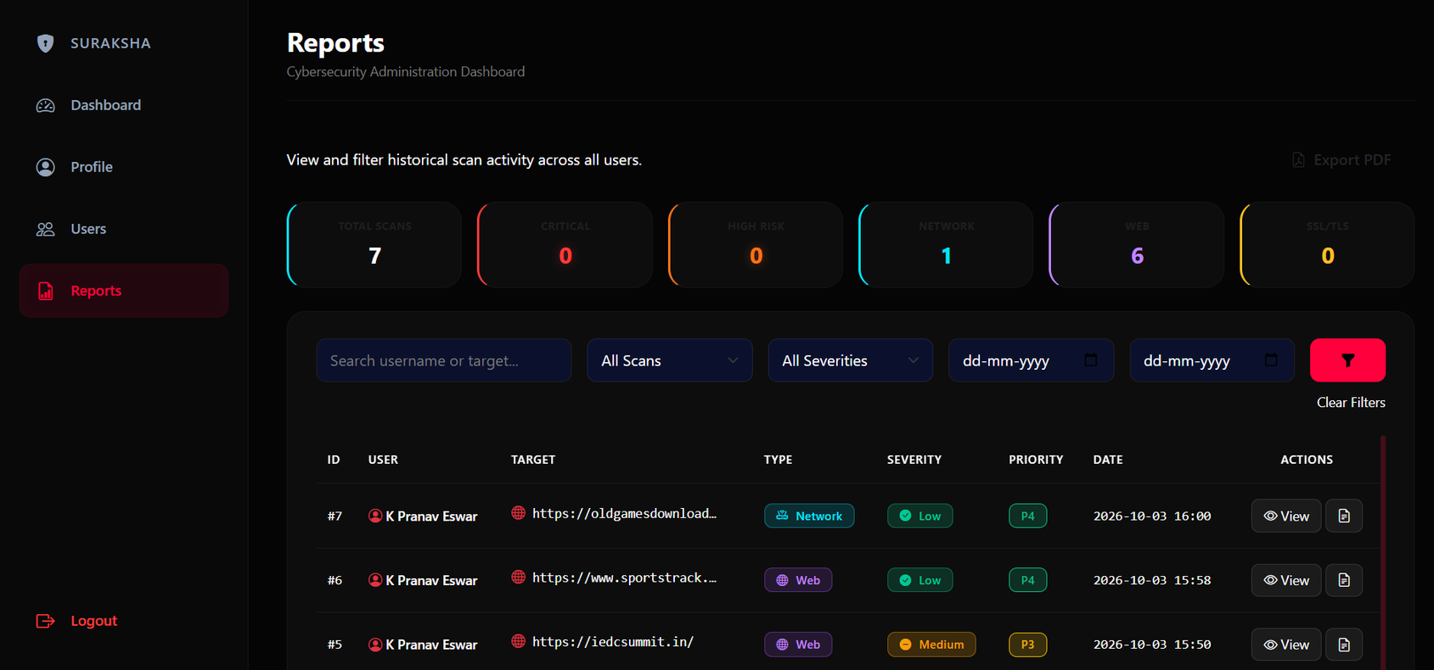
fig. admin reports
28

Slide 30
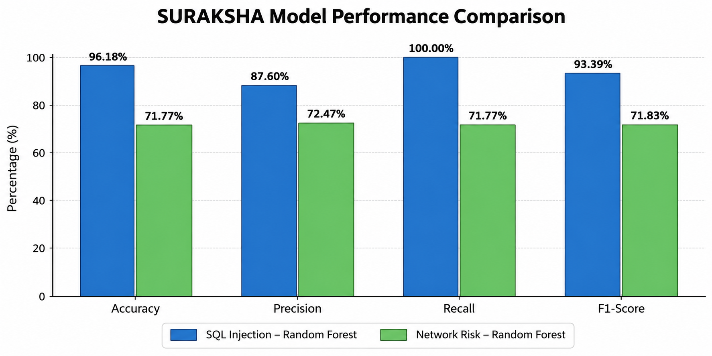
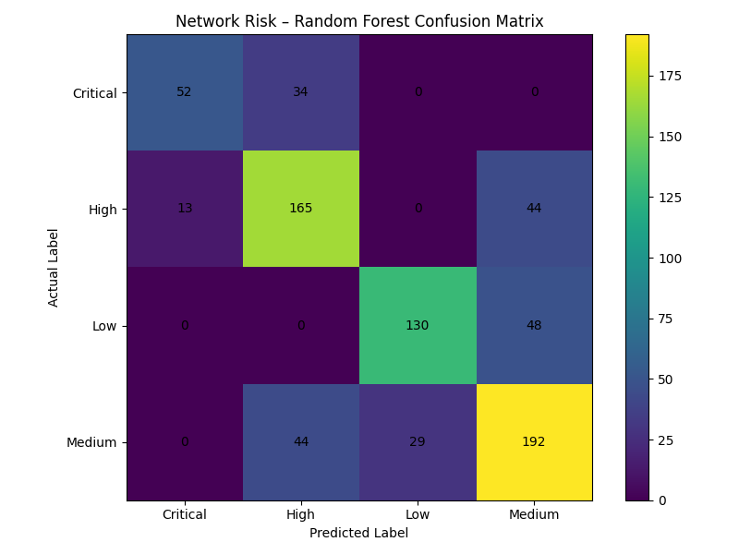
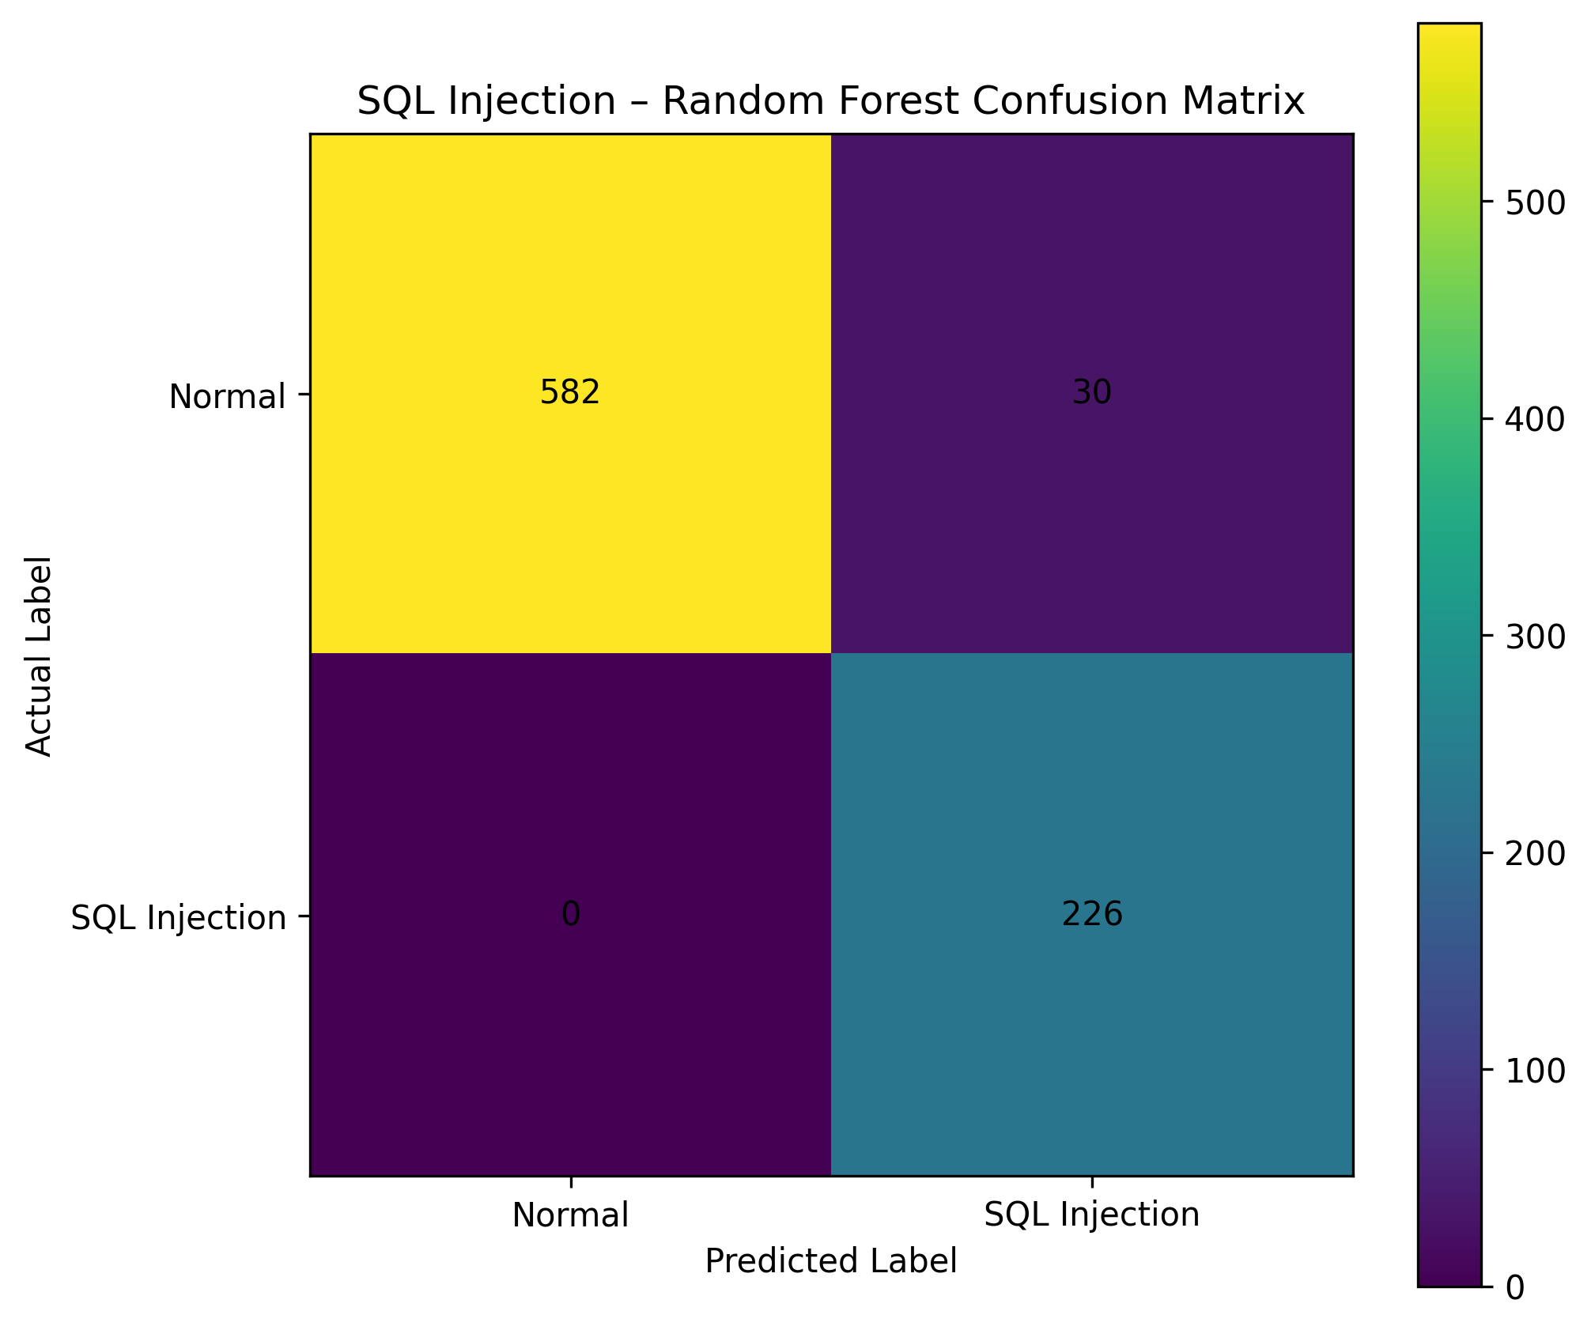
resultS
Model | Dataset | Accuracy | Precision | Recall | F1-Score
SQL Injection | 4,187 samples | 96.18% | 87.60% | 100.00% | 93.39%
Network Risk | 3,754 samples | 71.77% | 72.47% | 71.77% | 71.83%
29

Slide 31
REFERENCES
  Malkawi, M.; Alhajj, R. AI-Powered Vulnerability Detection and Patch Management in Cybersecurity: A Systematic Review of Techniques, Challenges, and Emerging Trends. Mach. Learn. Knowl. Extr. 2026, 8, 19. https://doi.org/10.3390/make8010019
  Bakır, R. UniEmbed: A Novel Approach to Detect XSS and SQL Injection Attacks Leveraging Multiple Feature Fusion with Machine Learning Techniques. Arab J Sci Eng 50, 15591–15604 (2025). https://doi.org/10.1007/s13369-024-09916-4
  Arasteh, B., Aghaei, B., Farzad, B. et al. Detecting SQL injection attacks by binary gray wolf optimizer and machine learning algorithms. Neural Comput & Applic 36, 6771–6792 (2024). https://doi.org/10.1007/s00521-024-09429-z
  OWASP Foundation. (2021). OWASP Top 10:2021. https://owasp.org/Top10/
  Lyon, G. (2025). Nmap Network Scanning: The Official Nmap Project Guide to Network Discovery and Security Scanning. Nmap Project. https://nmap.org/book/
30

Slide 32
CONCLUSION
  SURAKSHA provides an integrated platform for web and network vulnerability assessment.
  Combines web scanning, network reconnaissance, SSL/TLS analysis, protocol analysis, and CVE mapping.
  Uses rule-based security testing and machine-learning-assisted risk prediction.
  Provides centralized scan results, severity levels, risk scores, and security reports.
  Helps users identify vulnerabilities and understand their potential security impact.
  Reduces the need for multiple independent security assessment tools.
FUTURE ENHANCEMENTS
  Expand datasets and attack types to improve vulnerability detection.
  Detect obfuscated and unseen attacks using improved ML techniques.
  Improve CVE updates and security recommendations with regularly updated vulnerability information.
31

Slide 33
THANK YOU

